Slide 1

COBOL for the 21st Century
11th edition
John Wiley & Sons, Inc.
Nancy Stern
Hofstra University
Robert A. Stern
Nassau Community College
James P. Ley
University of Wisconsin-Stout
(Emeritus)

Slide 2
Decision Making Using the IF and EVALUATE Statements
Chapter 8

Slide 3
Chapter Objectives
To familiarize you with
1. IF statements for selection
2. Formats and options available with conditional statements
3. EVALUATE statement

Slide 4
Chapter Contents
Selection Using Simple IF Statement
Selection Using Other Options of IF
Using IF Statements to Determine Leap Years
Condition-Names
EVALUATE Statement: Using Case Structure as Alternative to Selection

Slide 5
COBOL Statements
Two categories
Conditional statements
  Performs operations depending on existence of some condition
  Coded with IF-THEN-ELSE structure
Imperative statements
  Performs operation regardless of existing conditions
  MOVE, ADD are examples in COBOL

Slide 6
IF Statement
IF condition-1
[THEN]
imperative statement-1 …
[ELSE
imperative statement-2 …]
[END-IF]
Format

Slide 7
IF Statement
If condition exists or is true
  Statement(s) after THEN executed
  ELSE clause ignored
If condition does not exist or is false
  Statement(s) after ELSE executed
  Statement(s) after THEN ignored

Slide 8
IF Statement Example
If Disc-Code = 1 Then
Multiply Amt By .15 Giving WS-Discount
Else
Move 0 To WS-Discount
End-If

Slide 9
IF Statement Example
If Disc-Code is 1, condition is true
  MULTIPLY statement executed
If Disc-Code is not 1, condition false
  MOVE statement executed
After selected statement executed, program continues with statement after END-IF

Slide 10
ELSE is Optional
May be omitted if operation required only when condition exists
If Acct-Balance < 0 Then
Display 'Account overdrawn'
End-If
DISPLAY executed if Acct-Balance less than zero, otherwise it is ignored

Slide 11
Relational Operators
Symbols for simple relational conditions
Symbol Meaning
< is less than
> is greater than
= is equal to
<= less than or equal to
>= greater than or equal to

Slide 12
Condition Examples
Assume L, M and N are numeric
L = 12, M = 7, N = 3
Condition Result
L >= M True
M < 7 False
M > N + 6 False
M + N <= 10 True

Slide 13
How Comparisons Performed
Compare fields to others fields or literals of same data type
Numeric fields compared algebraically
  005 < 026 < 539
All of these considered equal
  012 12.00 12 +12

Slide 14
How Comparisons Performed
Nonnumeric fields compared alphabetically
  ABLE < BAKE < BARK
Blanks on right do not affect comparison
All of these considered equal
  ABC ABCbb ABCbbbbb

Slide 15
Collating Sequences
When alphanumeric field has mix of upper-, lower-case letters and digits
  Result of comparison depends on collating sequence used on computer
Two types of internal codes to represent data
  EBCDIC mainly on IBM mainframes
  ASCII on PCs, minis, non-IBM mainframes

Slide 16
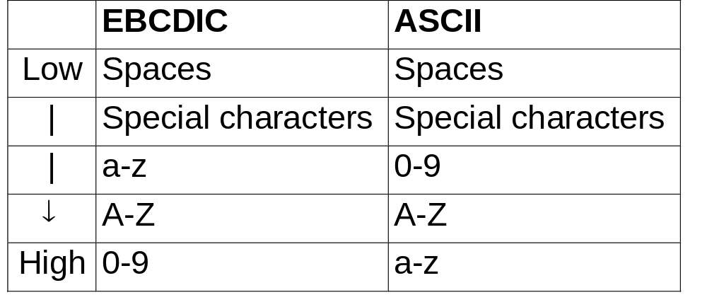
Collating Sequences

Slide 17
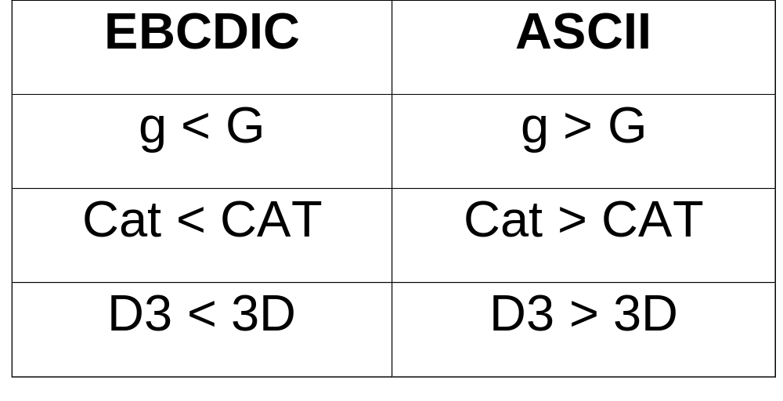
EBCDIC vs ASCII Comparison

Slide 18
CONTINUE clause
Used to indicate no operation should be performed when a condition exists
  If Amt1 = Amt2
  Then
  Continue
  Else
  Add 1 to Total
  End-If
No operation performed if Amt1 = Amt2, continues with statement after End-If

Slide 19
Nested Conditional
IF statement itself can contain additional IF statements
Pair each IF with an END-IF
Used when more than two conditions need to be tested

Slide 20
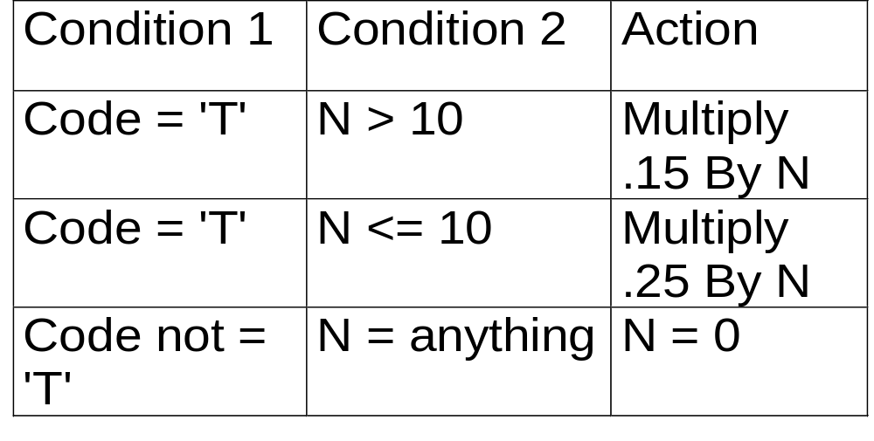
Decision Table
Often used to list conditions and actions to be performed

Slide 21
Code for Decision Table
If Code = 'T'
If N > 10
Multiply .15 By N
Else
Multiply .25 By N
End-If
Else
Move 0 To N
End-If
Delimits inner IF
Delimits outer IF

Slide 22
Compound Conditional
To test for several conditions with one statement
Code multiple conditions separated by ORs or ANDs

Slide 23
OR Compound Conditional
Use OR to test whether any one of several conditions exists
If A = B Or B > 12
Add A To Total
Else
Add 1 To Count
End-If
Executed if either condition exists
Executed only if A not = B and B <= 12

Slide 24
Implied Operands
When same operand used in compound conditions, operand can be named once
If X = 10 Or X = 20 may be written
If X = 10 Or 20
  Tests two simple conditions, X = 10, X = 20
  X is the implied operand in the second condition test

Slide 25
AND Compound Conditional
Use AND to test if all of several conditions are met
If A = 5 And B > 0
Add 10 To A
Else
Move 0 To B
End-If
Executed if both simple conditions met
Executed if one or both simple conditions not met

Slide 26
AND and OR in Conditionals
Compound conditions may include both AND and OR
Hierarchy rules
  Conditions with AND evaluated first from left to right
  Conditions with OR evaluated last from left to right
  Parentheses used to override this order

Slide 27
AND and OR in Conditionals
If Q > 0 Or R < S And R = 10
Multiply 2 By Q
End-If
Test conditions in this order:
1. R < S And R = 10
OR 2. Q > 0
Example

Slide 28
AND and OR in Conditionals
If Q = 2, R = 5, S = 16,
Test in (1) R < S And R = 10 is false
  Since R is not equal to 10 both conditions not met
Test in (2) Q > 0 is true
  One or conditions surrounding OR is met
  MULTIPLY statement will be executed

Slide 29
AND and OR in Conditionals
If conditions tested in this order result will be different
1. Q > 0 Or R < S
AND 2. R = 10
If Q = 2, R = 5, S = 16
Test in (1) is true
Test in (2) is false - both conditions not met so MULTIPLY not executed

Slide 30
Sign Tests
To test whether field is POSITIVE, NEGATIVE or ZERO
Condition Result
If Amt Is Positive True if Amt is greater
than 0
If Amt Is Negative True if Amt is less
than 0
If Amt Is Zero True if Amt equals 0

Slide 31
Class Test
To test whether type of data if field is numeric or alphabetic
Condition Result
If Amt Is Numeric True if Amt = 153
False if Amt = 15B
If Code Is Alphabetic True if Code = PQR
False if Code = P23

Slide 32
ALPHABETIC Class Tests
Reserved Word Meaning
ALPHABETIC A-Z, a-z, and blank
ALPHABETIC-UPPER A-Z and blank
ALPHABETIC-LOWER a-z and blank

Slide 33
Negating Conditionals
NOT placed before conditional reverses its truth value
Condition Result
If Amt Not = 10 True if Amt is 15
False if Amt is 10
If Amt Not > 8 True if Amt is 2
False if Amt is 12

Slide 34
Negating Conditionals
These two conditions are not the same
If Amt Is Negative
  True if Amt is less than zero
If Amt is Not Positive
  True if Amt is less than or equal to zero
  Zero (0) is neither positive or negative

Slide 35
Negating Conditionals
These two conditions are not the same
If In-Code Is Numeric
  True if Code is digits only
If In-Code Is Not Alphabetic
  True if In-Code contains any character that is not a letter
  Field with combination of letters, digits and special characters is neither NUMERIC nor ALPHABETIC

Slide 36
Negating Compound Conditionals
To negate compound conditional place it in parentheses, precede it with NOT
Condition to check for In-Code of S or D
If In-Code = 'S' Or In-Code = 'D'
To negate this condition (check for In-Code that is neither S nor D)
If Not (In-Code = 'S' Or In-Code = 'D')

Slide 37
Negating Compound Conditionals
May also use DeMorgan's Rule to negate compound conditions
For conditions separated by OR change OR to AND and use NOT in each condition
Condition to check for In-Code that is neither S nor D may be stated as
If Not In-Code = 'S' And
Not In-Code = 'D'

Slide 38
Negating Compound Conditionals
To negate conditions separated by AND change AND to OR and use NOT in each condition
Condition If A = B And C = D may be negated with either of these conditions
If Not (A = B And C = D)
If A Not = B Or C Not = D

Slide 39
Condition-Names
Meaningful names defined for specific values that an identifier can assume
Associate names with employee pay code values
Pay-Code Condition-name
H Hourly
S Salaried
Example

Slide 40
Defining Condition-Names
05 Pay-Code Pic X.
88 Hourly Value 'H'.
88 Salaried Value 'S'.
Define field in DATA DIVISION
Use level 88 to define condition-name and associated value
Example

Slide 41
Using Condition-Names
Use any place a condition can be used in PROCEDURE DIVISION
If Hourly
Perform Calc-Hourly-Pay
End-If
If Pay-Code field has a value of 'H', condition Hourly is true
Hourly same as condition Pay-Code='H'

Slide 42
Using Condition-Names
Condition-name must be unique
Literal in VALUE clause must be same data type as field preceding it
May be coded with elementary items with level numbers 01-49

Slide 43
Using Condition-Names
88-level may specify multiple values
05 Opt-Num Pic 9.
88 Valid-Options Value 1 Thru 5
Valid-Options true if Opt-Num = 1, 2, 3, 4 or 5

Slide 44
EVALUATE Statement
Used to implement Case structure
Tests for series of conditions
May be used in place of IF statement
Often code clearer, more efficient with EVALUATE when multiple condition need to be checked

Slide 45
EVALUATE Statement
identifier-1
EVALUATE
expression-1
WHEN condition-1
imperative-statement-1 …
[WHEN OTHER
imperative-statement-2 …]
[END-EVALUATE]
Format

Slide 46
EVALUATE Example
Add, subtract or multiply a number by 10 depending on value in Op-Code
Evaluate Op-Code
When 'A' Add 10 To Num
When 'S' Subtract 10 From Num
When 'M' Multiply 10 By Num
When Other Display 'Code invalid'
End-Evaluate

Slide 47
EVALUATE Statement
When Op-Code is 'A' the ADD statement will be executed
  Execution will continue with statement after END-EVALUATE
If Op-Code is not A, S or M, statement following When Other is executed

Slide 48
Chapter Summary
Simple relational conditons use the operators =, <, >, <=, >=
Simple IF Statement
  If condition exists, all statements up to ELSE clause or END-IF are executed
  If condition does not exist
    Statements after ELSE are executed
    Next statement after END-IF executed if no ELSE

Slide 49
Chapter Summary
Comparisons made
  Algebraically for numeric fields
  Using collating sequence for alphanumeric fields
Compound conditions join simple conditions with AND or OR
  ANDs evaluated before Ors in order left to right
  Parenthese used to override hierarchy rules

Slide 50
Chapter Summary
Other tests
  Sign tests - POSITIVE, NEGATIVE, ZERO
  Class tests - NUMERIC, ALPHABETIC
  Negated conditionals - may precede any test with NOT

Slide 51
Chapter Summary
Condition-names may be defined at 88 level
  Associates name with value a field may assume
  Use name as condition in PROCEDURE DIVISION
EVALUATE often used as alternative to IF or series of nested IFs

Slide 52
Copyright © 2003 John Wiley & Sons, Inc. All rights reserved. Reproduction or translation of this work beyond that permitted in Section 117 of the 1976 United States Copyright Act without the express written permission of the copyright owner is unlawful. Request for further information should be addressed to the Permissions Department, John Wiley & Sons, Inc. The purchaser may make back-up copies for his/her own use only and not for distribution or resale. The Publisher assumes no responsibility for errors, omissions, or damages, caused by the use of these programs or from the use of the information contained herein.

Slide 53
Decision Making Using the IF and EVALUATE Statements
Chapter 8

